Slide 1
Factors correlated with Suicide
Collin Michael Michael

Slide 2
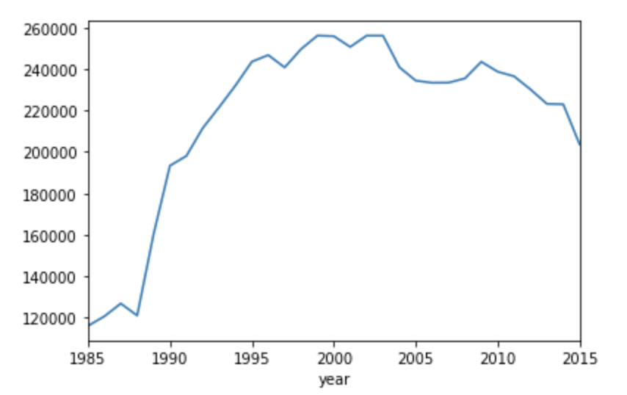
Year
By plotting suicide numbers against year, we can see that suicide has been gradually increasing since 1985, which skyrocketed in during 1988 to 1995, reaching its peak around 2002. After that, the suicide rate started to decrease.

Slide 3
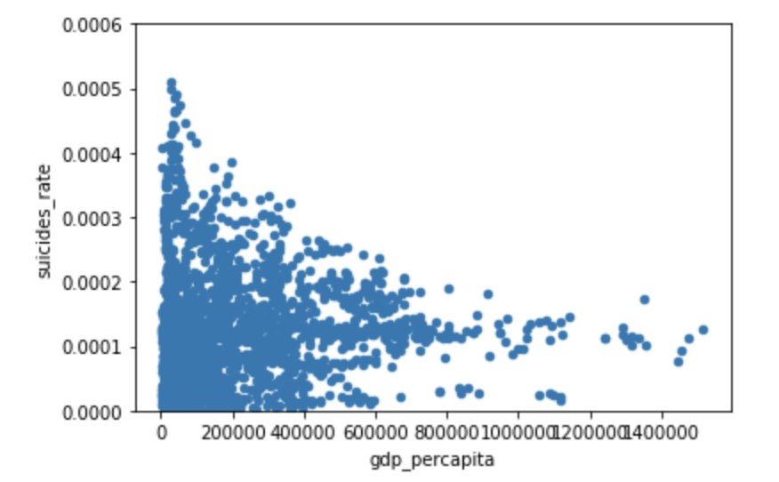
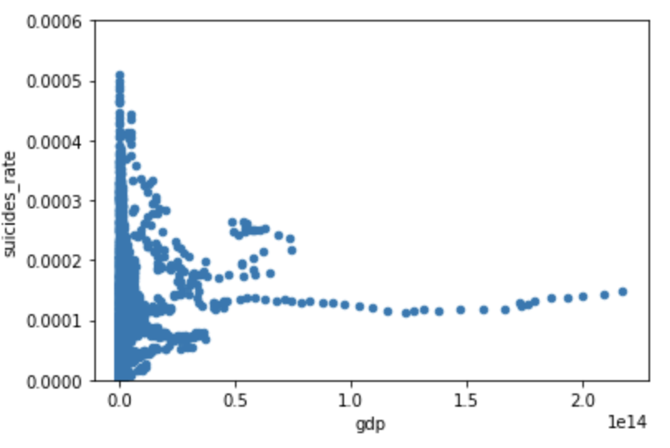
The first scatterplot shows the gdp per capita against the suicide rate, displaying a right skewed distribution. This indicates a negative relationship between GDP per capita and suicide rate. With the increase of GDP capita, suicide rate falls. Also the left side is more condensed, showing that the majority of the country has low gdp per capita and thus higher suicide rate.
The second graph displays similar distribution, showing a negative correlation between GDP and suicide rate. The right side is has a slight smaller slope, approximately horizontal, and eventually start to increase in the end. This indicates that if GDP increases to a certain point, the suicide rate start to increase instead of decreasing.

Slide 4
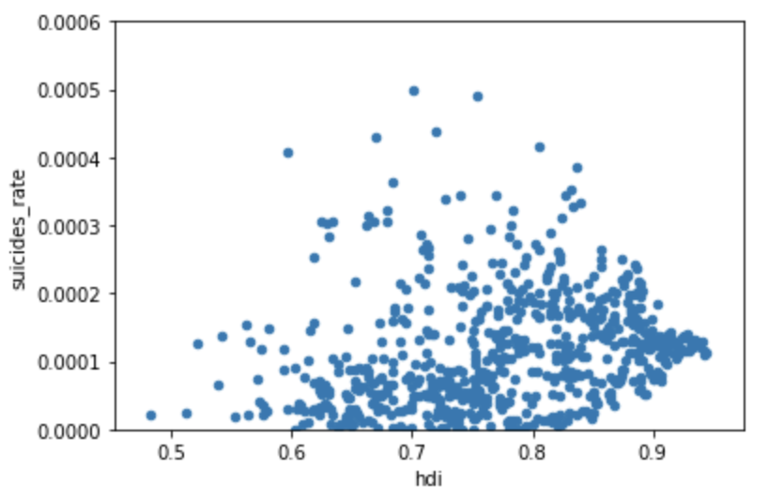
The scatter plot between HDI and suicide rate is a bit more complex. The right hand side is more condensed, and the scatterplot shows a rough right skewed distribution. This shows a positive correlation between HDI and suicide rates. With the increase of HDI, suicide rate increases, but will also start to decrease at a certain point. The graph has a lot of outliers, undermining the strength of the correlation. This may be due to the complexity of HDI, combining different factors into one index.

Slide 5
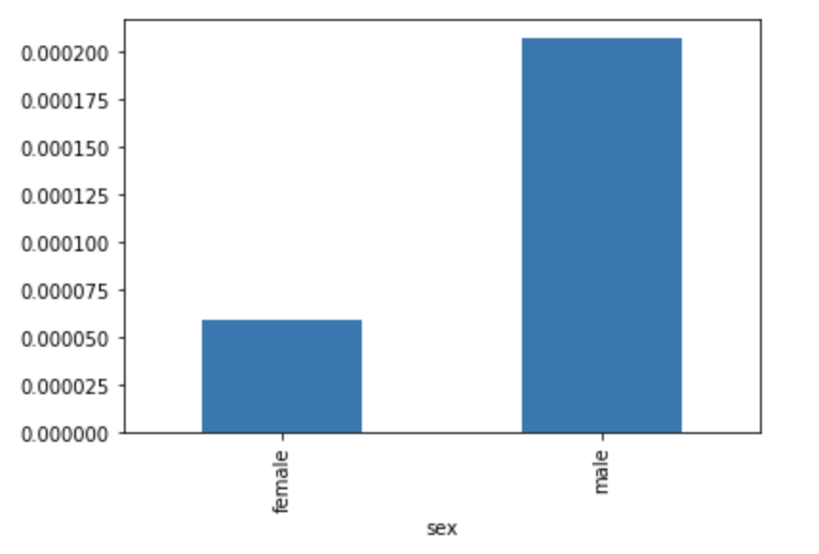
The relationship between gender and suicide rate is fairly straightforward as the bar chart shows. Male have a much higher suicide rate comparing to that of female.

Slide 6
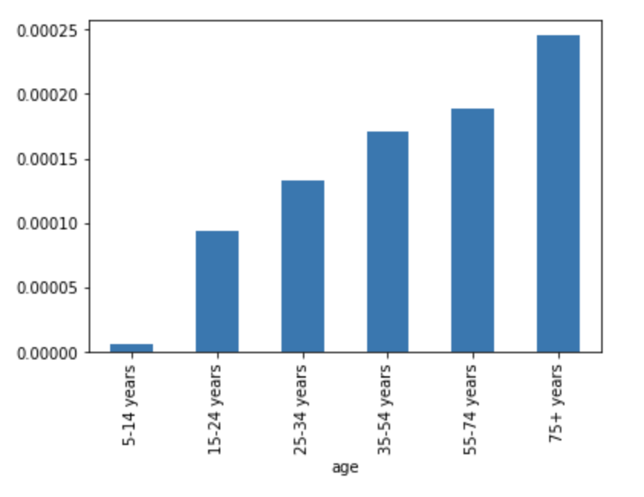
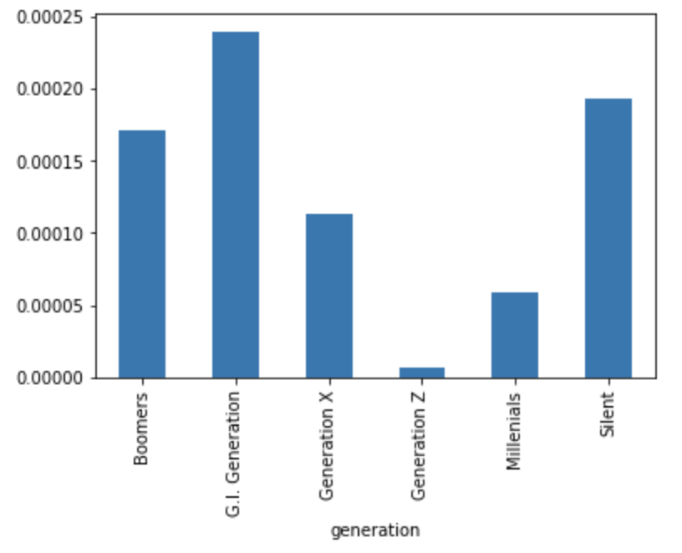
We then plot age and generation against suicide rate by using bar charts. As the chart shows, the suicide rate increases gradually increases with age increase, showing a strong positive relationship between age and suicide rate.
The second graph first displays an increase rate from Boomers to G.I Generation, then decrease from G.I generation to Generation Z, then another increase to Silent generation. This shows that there is not a linear relationship between generation born and suicide rate, but depends on different situations at the time. For instance, for G.I generation which has the highest suicide rate, many may have ended of their lives because of the post-war trauma. Thus no linear relationship can be made.

Slide 7
